Slide 1
Simulation of Quad Rotor and EDF-8
Pachu Chembukave

Slide 2
Goals
Model the quad rotor
Model the ducted fan
Create control algorithms to stabilize the models at some state
Make GUI to make simulation useful and easy to use
Switching models
Setting states
Saving data sets
Graphing variables

Slide 3
Modeling the Vehicles
Quad rotor model is based off Bouabdallah’s paper
State vector: [x y z phi theta psi x’ y’ z’ phi’ theta’ psi’]
Control vector: [U1 U2 U3 U4]
Some variables changed to reflect our system
The ducted fan model is based around AVID’s truncated linearized dynamics
State vector: [phi theta psi p q r]
Control vector: [d1 d2 d3 d4 dt]

Slide 4
Structure and Design of the Simulation
MATLAB classes made to represent each vehicle.
Both classes share common variables for simulation: run time, time step, control function, start state, and desired state; and shared functions for operation.
These classes make up the back end of the simulation GUI.
Control algorithms in the format control_vec = function(current_state, desired_state, time_step)

Slide 5
Control Algorithms
LQR controller for Quad Rotor
K matrix generated using MATLAB LQR function
Steady hover input controller for ducted fan
Started at the hover state and given hover state control vector

Slide 6
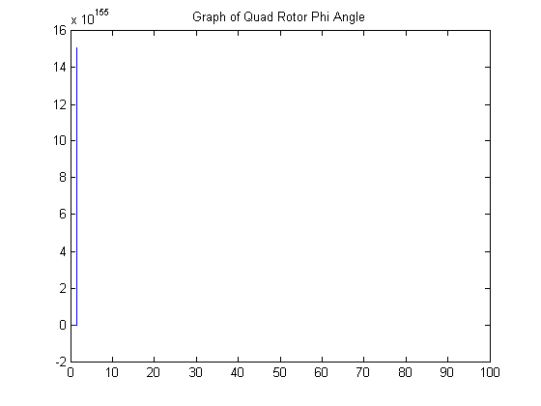
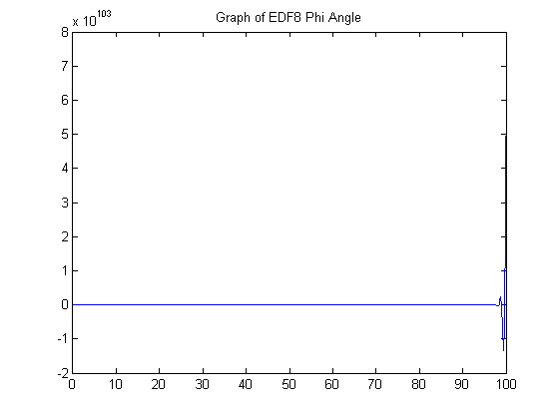
Results
Quad rotor and ducted fan models perform as expected
GUI functionality works as expected
Could not develop a stabilizing control algorithm, for either platform.
Algorithms seem to stabilize for some time, but then states exponentially deviate.

Slide 7
Conclusion
Can be used for analysis and testing of control algorithms and their effects on the system models
Can be used to further study how different inputs affect the system
MATLAB data is easily exportable and ready for analysis
Can be extended to support C++ functions

